Slide 1
Basic Electrical and Electronics Engineering
LECTURE 3.3
Dr. Sonam Shrivastava/ Assistant Professor (Sr.) /SELECT

Slide 2
BEEE102L
Basic Electrical and Electronics Engineering
DC Circuits
AC Circuits
Magnetic Circuits
Electrical Machines
Semiconductor Devices and Applications
Digital Systems

Slide 3
Books
Text Books
Allan R. Hambley, “Electrical Engineering -Principles & Applications”, 2019, 6th Edition, Pearson Education
V. D. Toro, Electrical Engineering Fundamentals, 2nd edition. PHI, 2014
Reference Books
R. L. Boylestad and L. Nashelsky, Electronic Devices and Circuit Theory, 11th edition. Pearson, 2012
DP Kothari & Nagrath, “Basic Electric Engineering”, 2019, Tata McGraw Hill

Slide 4
Module 3. Magnetic Circuits
Electromagnetic Induction: Self And Mutual
Magnetically Coupled Circuits
Series and Parallel Magnetic Circuits
Dot Convention

Slide 5
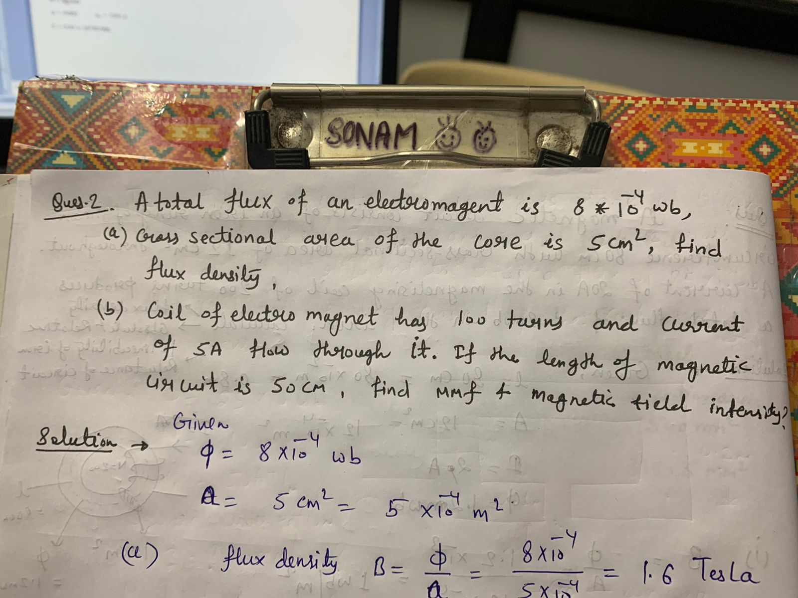

Slide 7
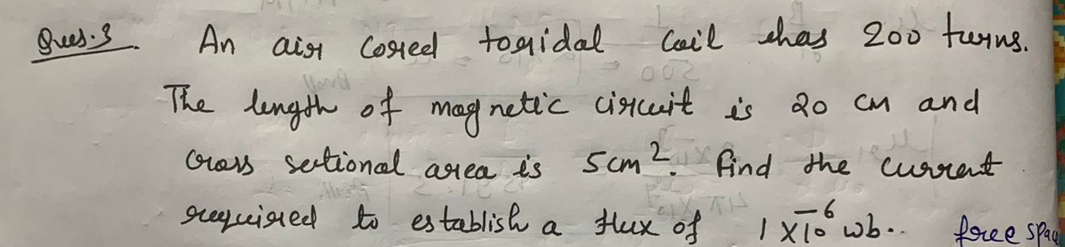

Slide 9
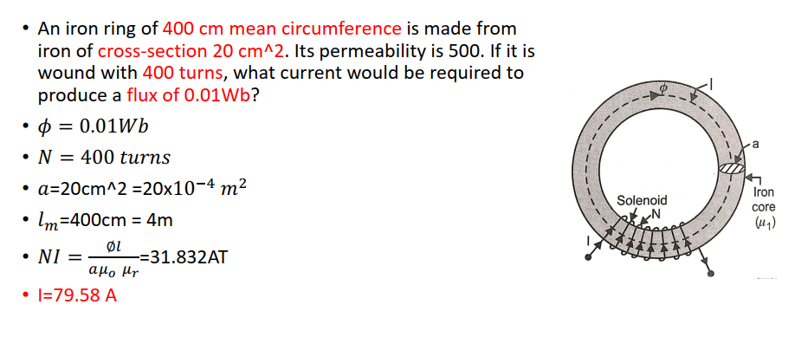

Slide 10
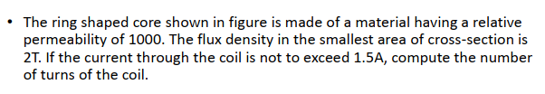
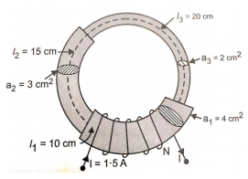
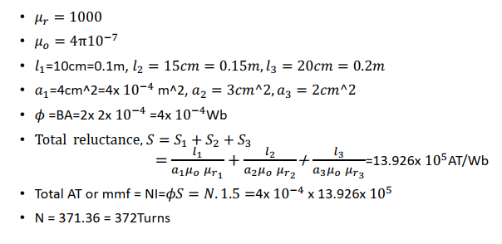

Slide 11
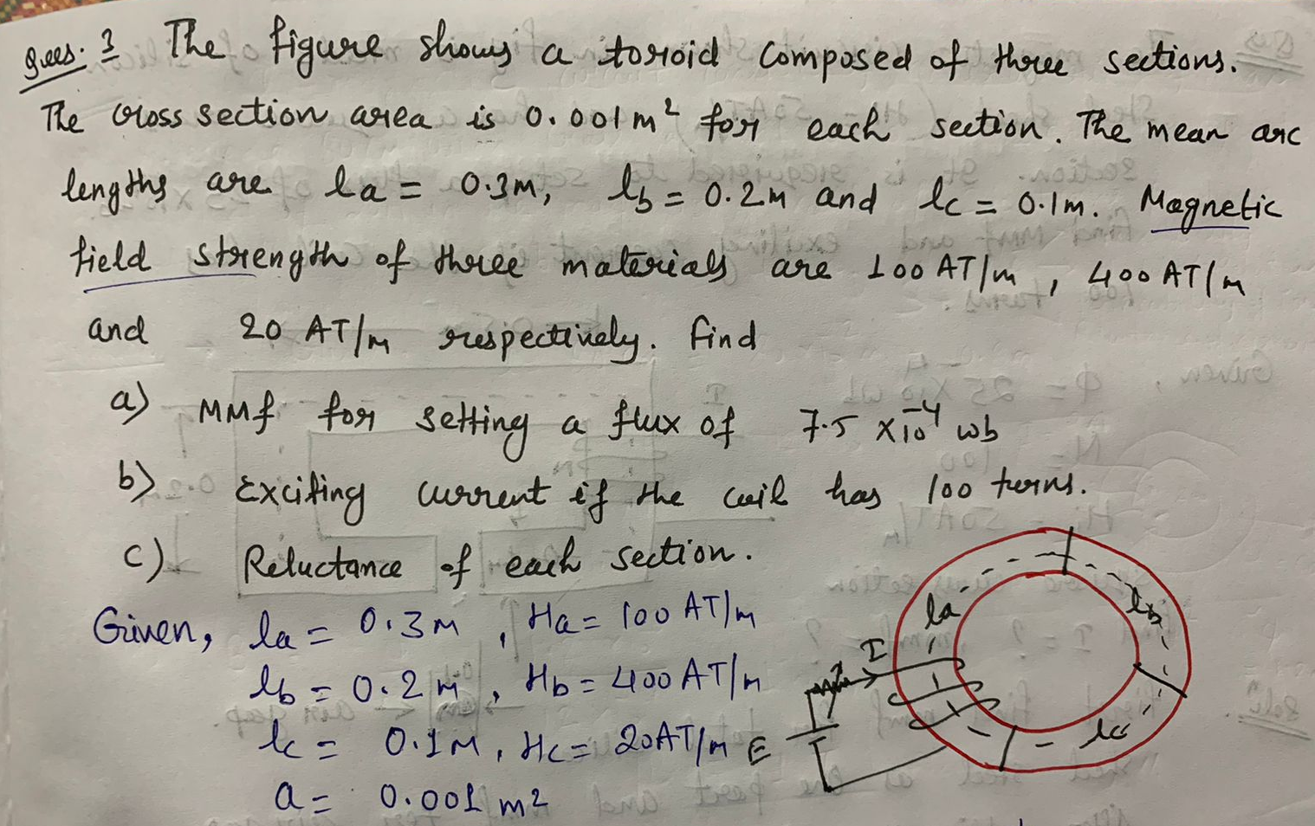

Slide 13
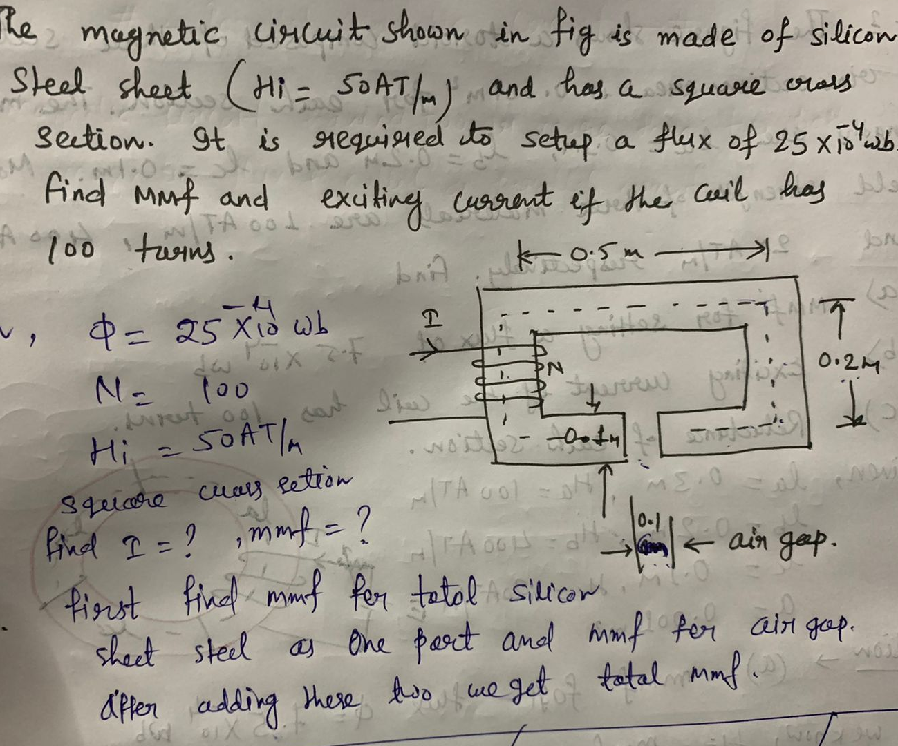

Slide 16
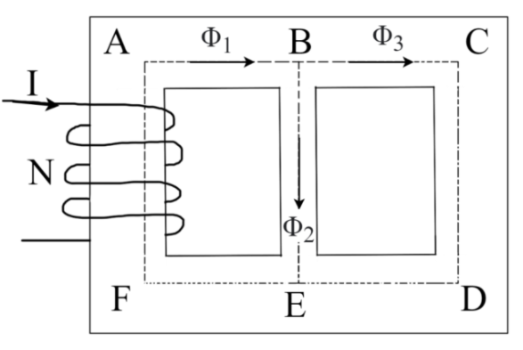
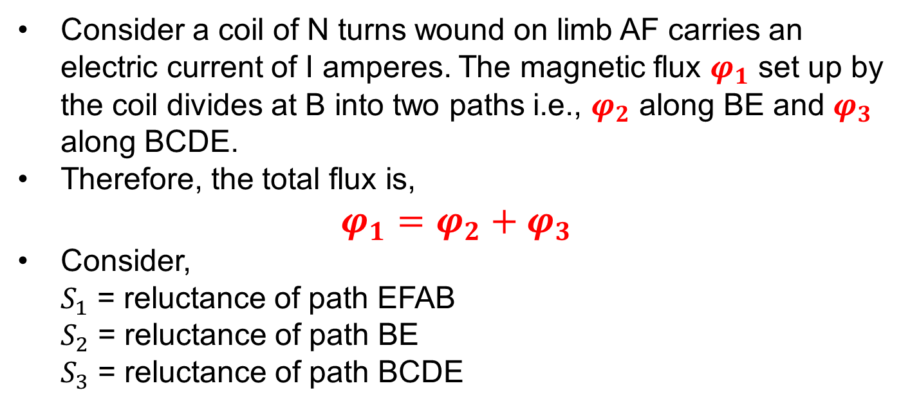
Parallel Magnetic Circuit
A magnetic circuit which has more than one path for the magnetic flux is called as parallel magnetic circuit.
Consider a coil of N turns wound on limb AF carries an electric current of I amperes. The magnetic flux $φ_{1}$ set up by the coil divides at B into two paths i.e., $φ_{2}$ along BE and $φ_{3}$ along BCDE.
Therefore, the total flux is,
$φ_{1}=φ_{2}+φ_{3}$
Consider, $S_{1}$ = reluctance of path EFAB $S_{2}$ = reluctance of path BE $S_{3}$ = reluctance of path BCDE

Slide 17
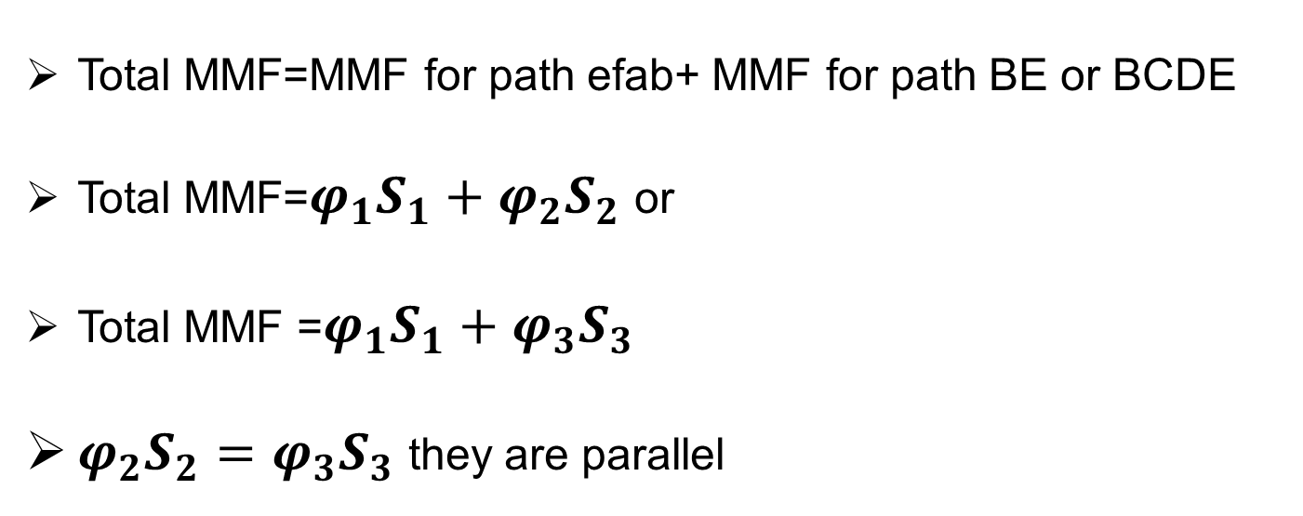
Parallel Magnetic Circuit
Total MMF=MMF for path efab+ MMF for path BE or BCDE
Total MMF=$φ_{1}S_{1}+φ_{2}S_{2}$ or
Total MMF =$φ_{1}S_{1}+φ_{3}S_{3}$
$φ_{2}S_{2}=φ_{3}S_{3}$ they are parallel

Slide 18
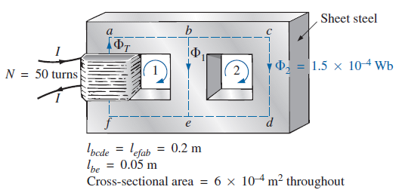
Example: Determine the current I required to establish a flux of 1.5x10^-4 Wb in the section of the core indicated in Fig. The relative permeability of the material is 1200.

Slide 19
Example: Determine the current I required to establish a flux of 1.5x10^-4 Wb in the section of the core indicated in Fig. The relative permeability of the material is 1200.

Slide 21
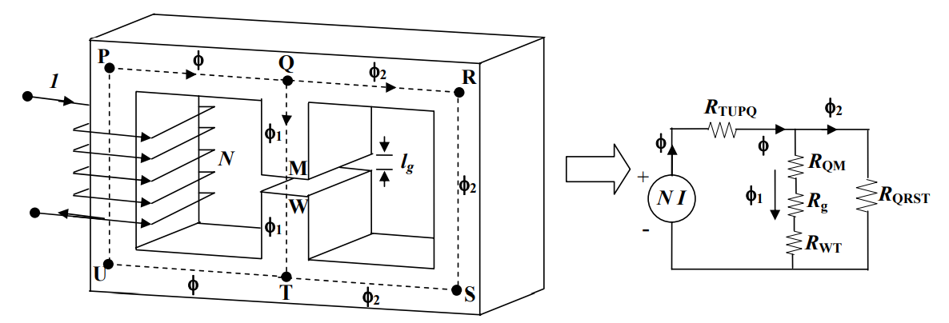
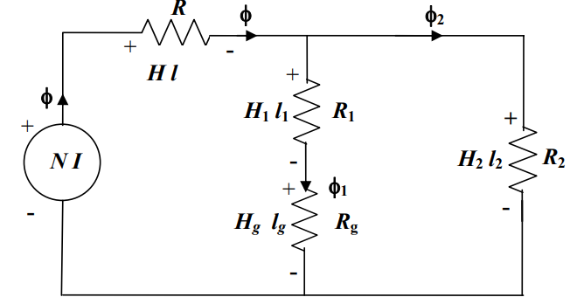
Series-parallel Magnetic circuits

Slide 22
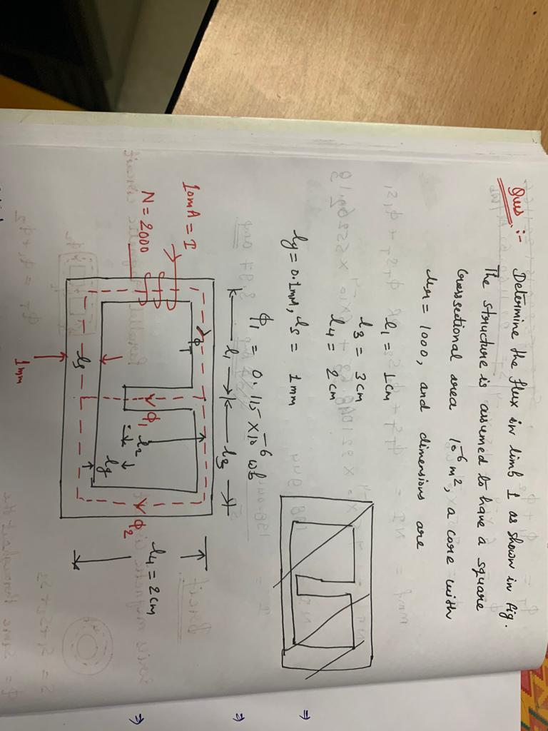

Slide 27
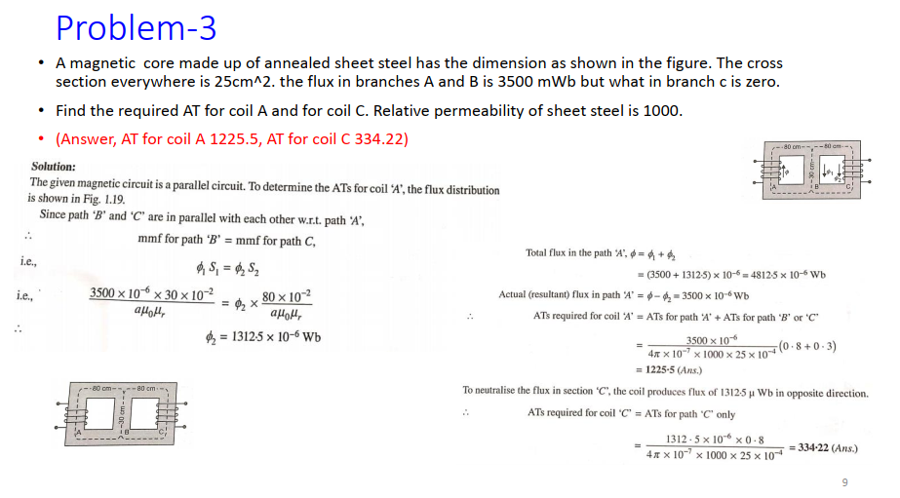

Slide 28
